Slide 1

Department of Information and Technology
CRYPTOVISION :
AI based Prediction of Crypto and Stocks
Batch-5
Anjan Kumar-23N31A05AN
Durga prasad-23N31A05AY
Under the guidance of G.Likitha Asst.professor

Slide 2
AGENDA
ABSTRACT
INTRODUCTION
EXISTING SYSTEM
PROPOSED SYSTEM
SYSTEM REQUIREMENTS
UML DIAGRAMS
SAMPLE CODE
OUTPUT SCREENS
CONCLUSION

Slide 3
ABSTRACT
Crypto Vision is the cuting edge cryptocurrency analytics platform to help investors better navigate this rapidly changing digital asset marketplace with greater confidence. It employs real-time data feeds and machine learning algorithms for tailored investment recommendations and personalized insights for optimizing portfolios while minimizing risks. The platform provides real-time market data, including price fluctuations, trading volumes, and sentiment analysis, while also integrating tools for risk management, such as stop-loss limits and diversification strategies.
With a comprehensive portfolio tracker, educational resources for all experience levels, and a vibrant community for ongoing support, Crypto Vision equips users with the tools needed to make informed decisions, whether they are seasoned traders or new investors. Advanced encryption, ensuring personal information and investments are protected from security threats, is prioritized. Crypto Vision is your safest trusted partner when it comes to making data-driven investment choices and staying ahead in the evolving cryptocurrency landscape.

Slide 4
INTRODUCTION
In the fast-paced world of cryptocurrencies and stock markets, making
informed investment decisions is crucial. CRYPTOVISION is an AI-powered
prediction system designed to analyze market trends, predict price movements, and
provide actionable insights for traders and investors. Leveraging advanced machine
learning models, including deep learning, and real-time data analytics, we processes vast
amounts of financial data, social media sentiment, and historical trends to deliver precise
forecasts.
Our system empowers users with:
Real-time price predictions for crypto and stocks
Trend forecasting using AI-driven insights
Risk assessment for smarter investment strategies
By combining the power of AI with financial expertise, this project aims to enhance financial literacy and guide users toward better investment decisions in an ever-changing market.

Slide 5
EXISTING SYSTEMS
1 . Time Series Models (ARIMA, LSTM, Prophet):
How They Work: Use historical price and volume data to forecast future trends.
Real-Time Data Sources: API feeds from exchanges (price, volume, order book depth).
Drawbacks:
Struggle with extreme volatility and unpredictable market shocks.
Limited in incorporating non-linear relationships or external factors like news.
2 . Reinforcement Learning (RL) Models:
How They Work: Models "learn" by interacting with the market environment to maximize rewards (e.g., profit).
Real-Time Data Sources: Exchange APIs, market sentiment, and order books.
Drawbacks:
High computational cost and training time.
Risk of overfitting to historical patterns, leading to poor generalization.

Slide 6
PROPOSED SYSTEM
Combine Diverse Data Sources Why This Works:
Relying solely on a single data source—such as real-time market prices—can make predictive models fragile, especially in volatile or uncertain market conditions. Markets are influenced by a multitude of factors including news sentiment, macroeconomic indicators, social media trends, technical patterns, and even geopolitical developments. When a model only considers one of these dimensions (e.g., historical stock prices), it may miss critical signals or context that could improve prediction accuracy or risk assessment.
By integrating diverse data sources, such as:
Market data (price, volume, technical indicators),
News and sentiment analysis (from financial news or platforms like Twitter),
Macroeconomic indicators (interest rates, inflation, employment data),
Company fundamentals (earnings, balance sheets, P/E ratios),
Alternative data (web traffic, satellite imagery, weather patterns),
models can develop a more holistic understanding of market dynamics.

Slide 7
SOFTWARE REQUIREMENTS
Code Editor: VS Code.
Web Browser: Google Chrome, Firefox and Microsoft Edge for testing and debugging.
API calling : CoinGecko and OpenAI
Modern Web Browsers: HTML, CSS. JavaScript and Python.
HARDWARE REQUIREMENTS
Processor: Intel Core i5 or AMD Ryzen 5 (or higher)
RAM: 8 GB (16 GB recommended for better performance with ML models)
Storage: 256 GB SSD (minimum) or higher.
Operating System: Windows 10/11, macOS, or Linux.

Slide 8
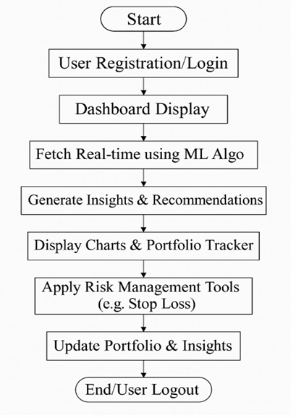
UML DIAGRAMS
FLOWCHART DIAGRAM :

Slide 9
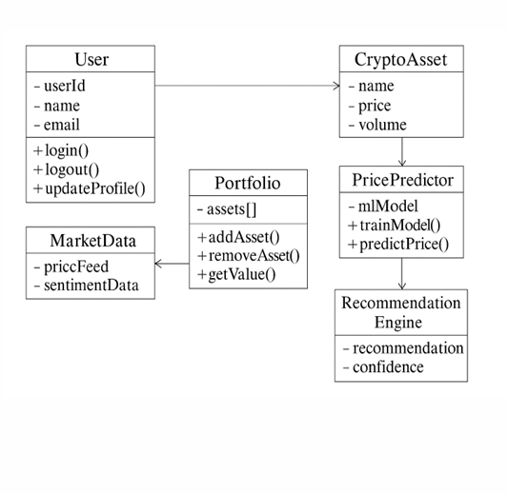
CLASS DIAGRAM :

Slide 10
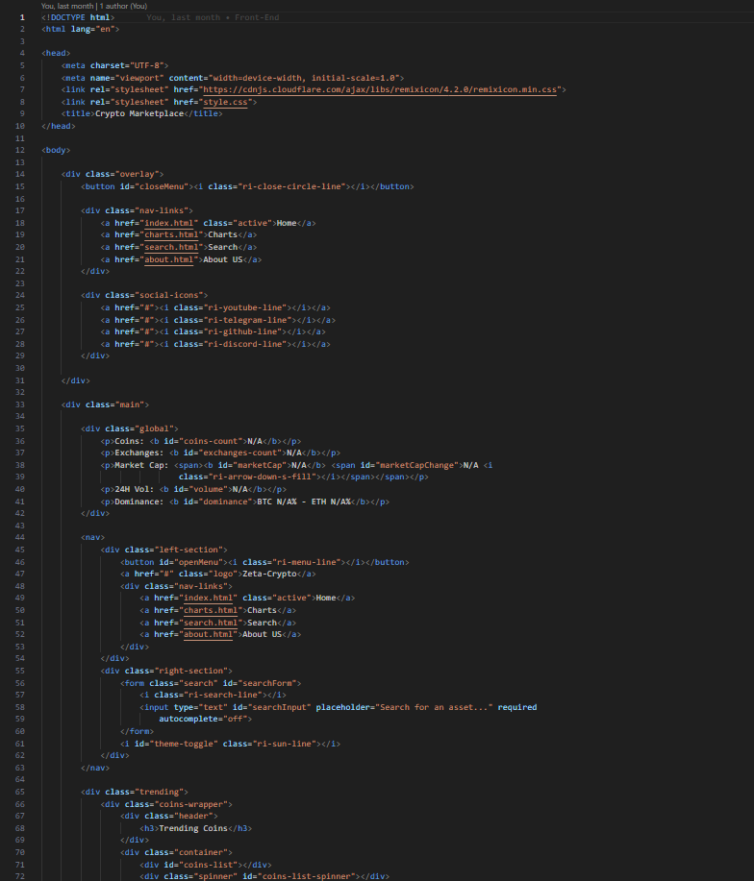
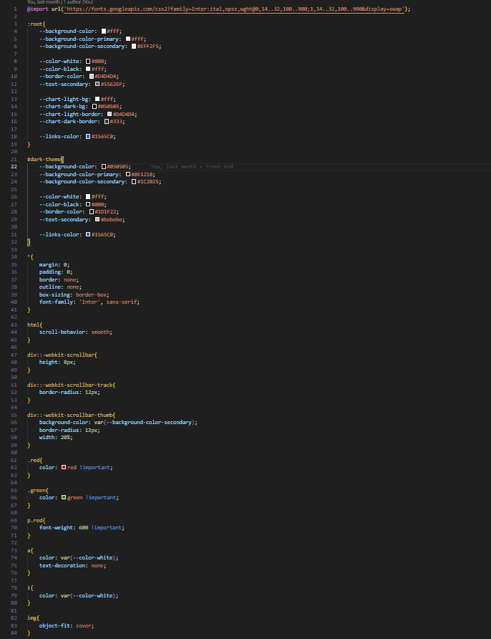
SAMPLE CODE

Slide 11
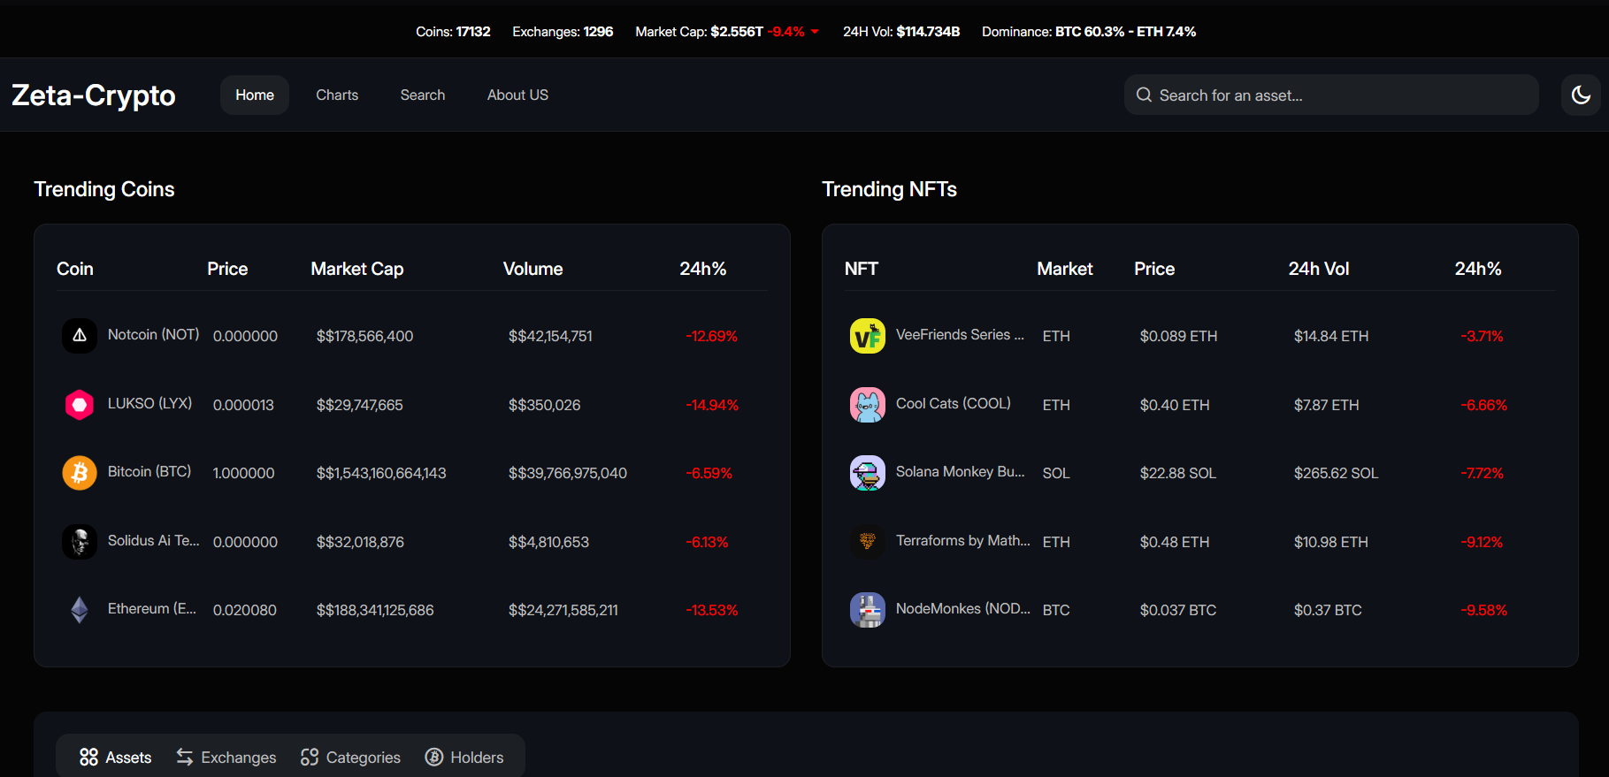
OUTPUT SCREENS

Slide 12
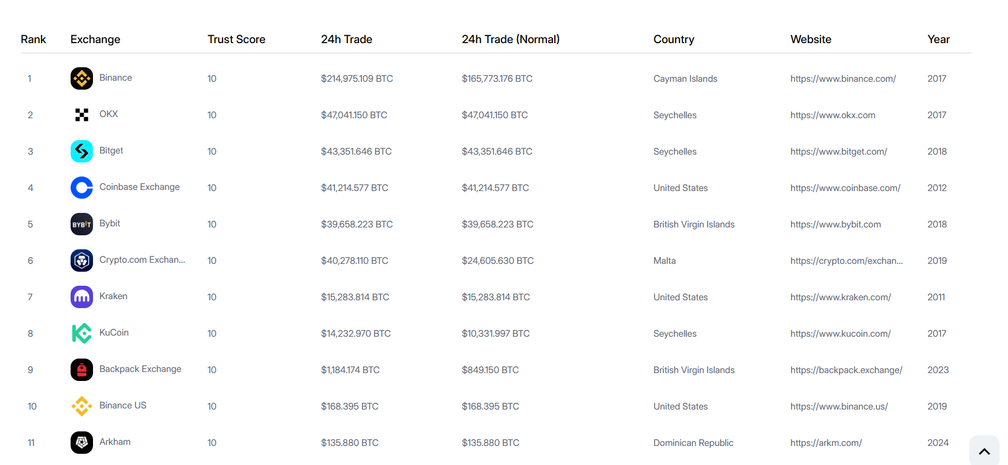

Slide 13
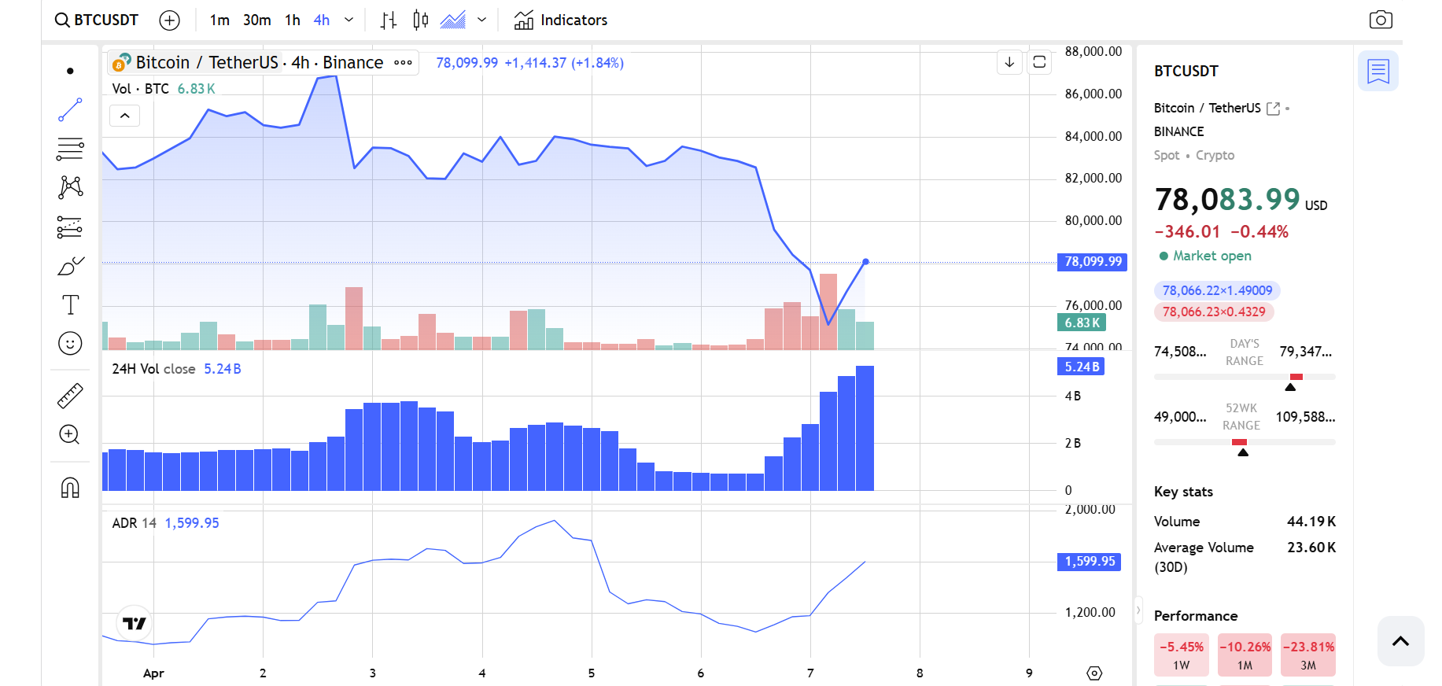

Slide 14
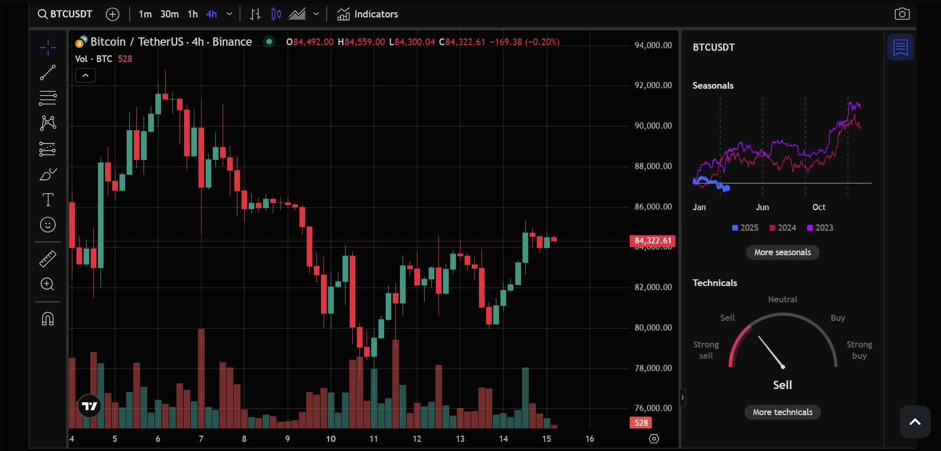

Slide 15
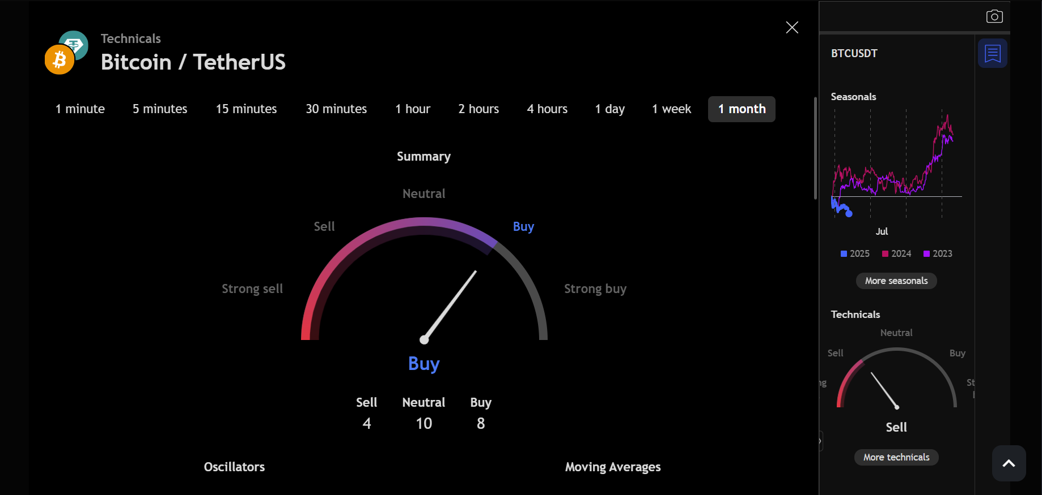

Slide 16
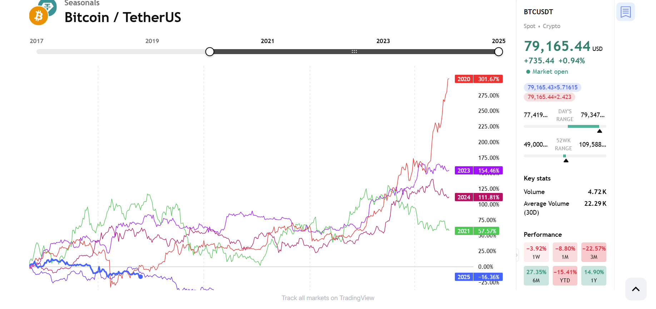

Slide 17
CONCLUSION
Crypto Vision is a powerful and innovative platform designed to help investors navigate the dynamic cryptocurrency market with confidence. By leveraging real-time data, machine learning algorithms, and advanced risk management tools, it provides valuable insights and personalized investment recommendations. Whether you are an experienced trader or just starting out, Crypto Vision equips you with the necessary tools to optimize your portfolio, mitigate risks, and make informed decisions. With a strong focus on security and user empowerment, Crypto Vision is the trusted partner for those looking to stay ahead in the evolving world of digital assets

Slide 18
THANK YOU

